Slide 1
PAYROLL INDUCTION
US and Canada

Slide 2
KEY INFORMATION
All employees are paid bi-weekly, every other Friday.
The Travelport work week runs Saturday to Friday.
Salaried employees are paid current – for time worked up to and including pay day.
Hourly employees are paid in arrears – paid the Friday after work was completed.
When the pay day falls on a company observed or banking holiday, pay checks are issued the prior business day.
Pay slips are visible 3 days prior to pay day.
US employees may elect to receive their W-2s electronically. T-4s and RL-1s will be provided electronically to Canadian employees.

Slide 3

Systems Used
Travelport, LP uses UKG Pro and Workforce Management to:
Calculate payroll.
Submit leave requests.
View pay slips.
View year-end forms.

Slide 4
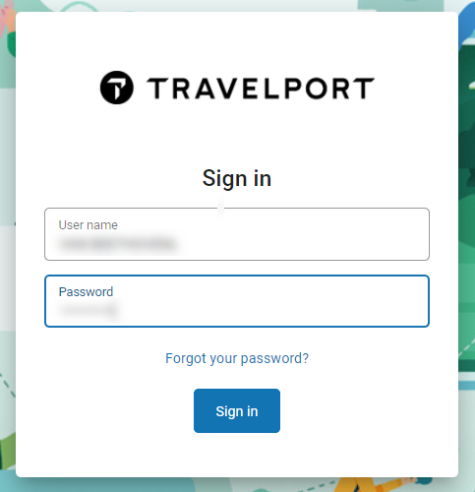
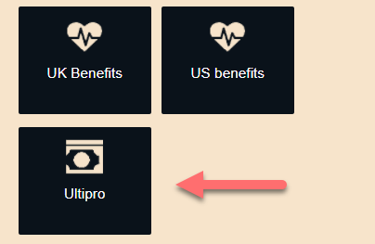
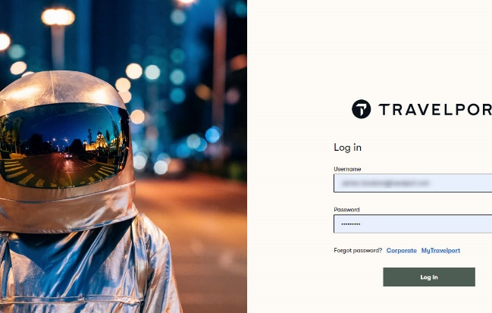
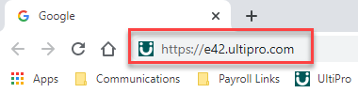
Accessing UKG Pro on laptop or pc
The following will help you log in via SSO for the fist time. Thereafter, the URL should only be used when not connected to VPN.
Enter the direct URL into a fresh Chrome session – no other sessions should be open:
https://e42.ultipro.com
Enter your UKG Pro login credentials. This will be used both outside of the Travelport network, and when you leave Travelport.
Password: 8-digit DOB (mmddyyyy)
Username: Contact Payroll-US Team
You will then be prompted to create a new password, along with security questions.
Once logged in, close out of Chrome altogether.
Open Homeport in a new Chrome session. Again, no other session should be open.
Select the “UltiPro” tile from the list of single sign-on applications.
You will then be prompted to create a new password, along with security questions.
Once logged in, close out of Chrome altogether.
A single sign-on login screen will appear.
Here enter your network login credentials.
Thereafter, you should be able to log into UKG Pro by clicking the “UltiPro” tile on Homeport.
You’ll need to change your SSO password any time your network or UKG password is reset.

Slide 5
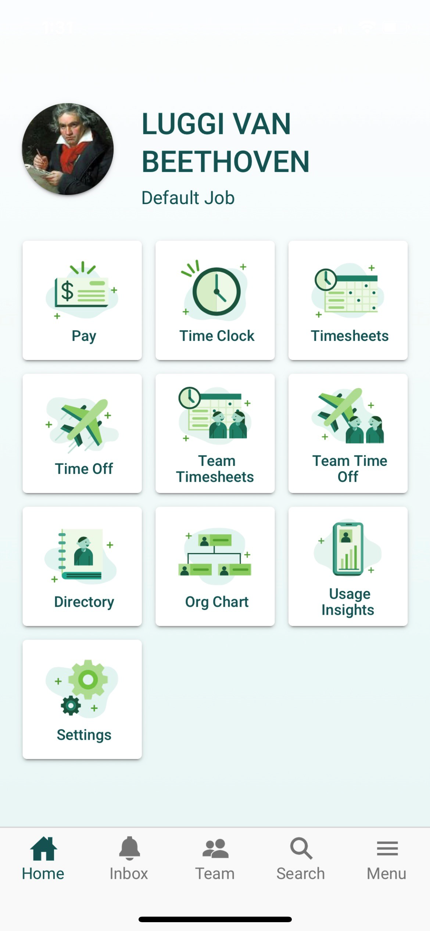
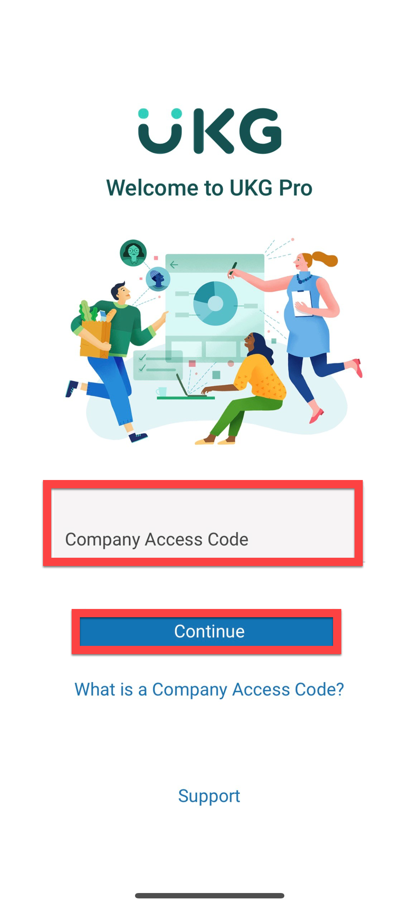
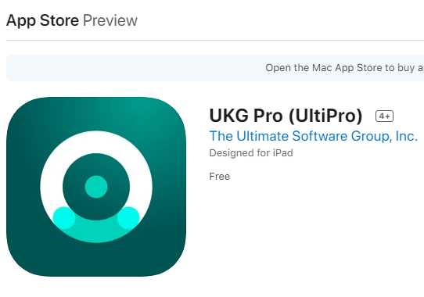
Accessing UKG Pro by mobile app
The following will help you log in via Mobile App.
Download the UKG Pro (UltiPro) Business App from your App Store (compatible with iPhone, iPads & Android Phones Tablets).
Open the app and enter the Company Access code: 1Travelport
Click the “Continue” button.
On the following screen you will have the option to enter your SSO or network login credentials, or your UKG Pro (UltiPro) username and password.
You will then be able to do such things as access your pay information, submit/approve/cancel leave requests, and even view your year-end tax forms.

Slide 6

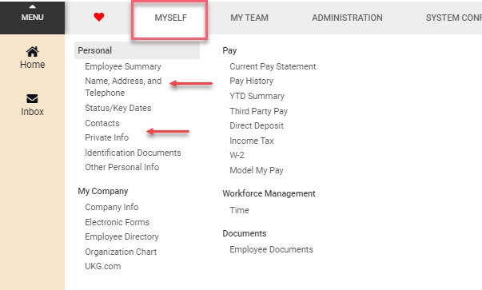
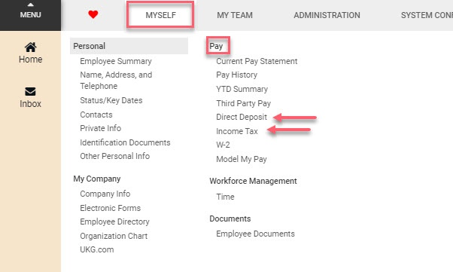
Before the first payroll
Before the first payroll
Review the following items to help ensure an accurate first pay check.
Log into UKG Pro and review Personal, Direct Deposit and Tax information.
Personal Information
“Name, Address and Telephone” to review your contact information.
“Private Info” to review your SSN (US) or SIN (Canada).
Direct Deposit and Tax
“Direct Deposit” to enter your direct deposit information.
“Income Tax” to enter your withholding information.

Slide 7
Questions?

Slide 8

HOW TO CONTACT US
For any payroll-related questions, or if you would like help understanding your payslip better, please contact us at Payroll-US@travelport.com.
If you believe there is a discrepancy in benefit withholdings contact Benefits-US@travelport.com.
For changes or corrections to personal information in Oracle HCM contact peopleservices@travelport.com.
For advice on tax withholding elections, please consult with your tax preparer.

